Slide 1
The Mean Stack
Peter Kavounas

Slide 2
What is the MEAN Stack
Stack: A group of programs that work in tandem to produce a result or achieve a common goal (techopedia.org)
It is a software bundle used to create web servers
It is not the only way to create web servers (see LAMP Stack, WAMP Stack, and MAMP Stack)
It utilizes JS, so all the problems with JS are included

Slide 3
What Does “MEAN” MEAN?
MongoDB (database)
Express (server controller)
Angular (frontend presentation)
NodeJS (server)

Slide 4
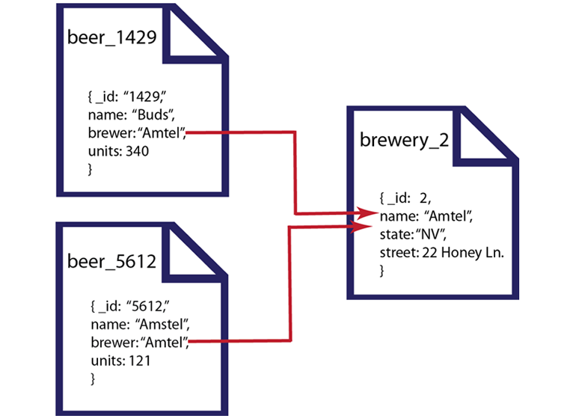
Mongo DB
NoSQL database
Document-Oriented DB
Can be locally hosted or remotely hosted by service provider
Nicer looking schema

Slide 5
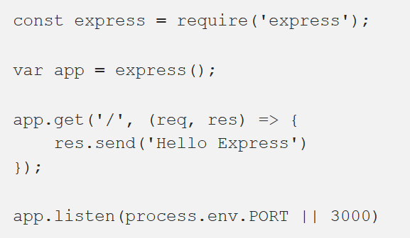
Express
Communications framework
Allows server to talk to browser to display content
URL route generation is a breeze

Slide 6

Angular (The One I didn’t Use)
Extends HTML with new attributes
Allows for neat single-page apps
Meant for front-end JS
React.js serves the same purpose, which turns the MEAN Stack into the MERN Stack
You can have a page put the value from an input field into HTML as it is being typed in 2 lines

Slide 7
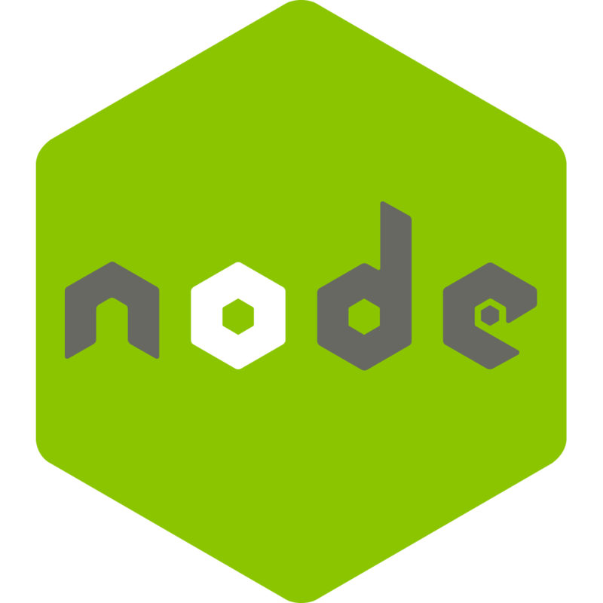
Node.js
The actual server part of your web server
Runs JS outside of the browser
The foundation that Express.js sits on
Single-threaded

Slide 8
NODE.JS VS. Spark JAVA
Category | node.js | Spark
Foundation | “JS is an abomination” –Mr. Mein | Solid foundation
Code Editing | Any text editor works | NetBeans, Eclipse, IntelliJ
Debugging | Have you ever tried to debug in VS Code? You can’t. | NetBeans has actual debugging tools for you to use.
Fails silently? |  | Nope
Speed | Server starts in a flash | Takes 30 seconds to start server, and 30 minutes to start NetBeans

Slide 9
NODE.JS VS. Spark JAVA Cont.
Category | node.js | Spark
Threads | Single | Multiple
Database Queries | Node.js is part of the MEAN Stack and MongoDB is written in JS | You must make requests in SQL schema and then parse into Java
JSON | JSON is a part of JS, and reading it is easier | Again, you must parse
Cross-compiling? | Yep | Totally

Slide 10
The point?
USE WHATEVER YOU’RE COMFORTABLE WITH!

Slide 11

Bonus round!
The magical world of web sockets!
Don’t use them (for your sake).
Don’t listen to Quinn, no matter how much he tries to sell you web sockets.
They don’t offer much of an upgrade.
If you want to learn about Socket.io, learn the MEAN Stack first.

Slide 12
Thank you

